Slide 1
Is native-speakerism attainable?
By Jayvan Lean
Critically explores the societal and individual barriers L2 learners of English experience, and how these affect their ‘native’ speaker pursuit.
Special emphasis on a Japanese & Romanian learner and how their learner profiles were affected through the above and their attitudes to English.

Slide 2
Content
Reasons for language learning and societal barriers/pressures
Reasons and effects of ‘native’ speaker desire
Individual L2 barriers
Grammatical barriers
Phonetical barriers
Implications and thoughts for teachers: the bigger picture
Conclusion
References

Slide 3
Reasons for language learning and societal barriers/pressures
English is enough! The world’s companies need English speakers! (Coleman 2009).
English ownership. (Wicaksono 2013).
Complacency (Coleman 2009).
Xenophobia/Europhobia (Coleman 2009).
The media reinforce these aspects! (Coleman 2009).
Self-concordant goals: meaningful, individually realised and an expression of the self = persistence and diligence (Sheldon & Elliot 1999).
Andrei
Extrinsic
Intrinsic
Foreign language learning in the European Union (UOE data collection 2015).
Motivation!
High motivation for languages of intrinsic interest; contrary findings for language learners who study not of their own volition (Schmidt & Watanabe 2001).
Taiko
Modern Language Association of America (no date).

Slide 4
But! Obsession with ‘native speaker’ image
“I know English is the world’s language, so I want my speech and grammar to be ‘native’ like. That way, I can get a job overseas!
“The sector I want to work in and the media I consume is dominated by English; therefore, I want my English to be as ‘native’ as possible.”
“I worry about how I will perceived by ‘native’ speakers, and it makes me do things like this in conversation!”.
Competent, yet…
Andrei
Taiko
Heuristic Model of Variables Influencing WTC (MacIntyre et al. 1998, p. 547).
“Sometimes I ask one of my housemates to make important phone calls (letting agency, internet provider etc.) as they are ‘native’ speakers “
Analyst: “How do I get to the bus stop?” Learner: “From the school you turn l-r...right and then you walk in straigh-, no… in a straight line for three minutes”.
Relationship between the user and the L2: believe and competence in their L2 skills (MacIntyre et al. 1998).
Language anxiety, i.e. any discomfort experienced when conversing in the L2. (MacIntyre et al. 1998).
Possible fears of integration and bad L2 experiences contribute to low WTC (MacIntyre et al. 1998).

Slide 5
Individual L2 language barriers.
“It’s hard for me as a Japanese: grammar and pronunciation is quite different ”.
Andrei
Grammar & phonetic differences = more anxiety
Students studying languages out of intrinsic interest = highly motivated; however, they had very low self-efficacy and expectations of success (Schmidt & Watanabe 2001).
Taiko
Problem with English phonemes such as /l/ and /r/.
Displayed difficulties with articles, past tense forms, and the plural s.
Worry words: those which are spelt awkwardly and are hard to pronounce (Ellis & Barkhuizen 2005). E.g. ou - /ʌ/; <country> - /kʌntri/ - /'ka̝ːntri/.
Intensifying adverb usage & definite/indefinite articles.
Myth 4: Children are taught their first languages
(Hall, Smith & Wicaksono 2017).
Myth 5: some people speak their language without an accent
(Hall, Smith & Wicaksono 2017).
More on these later!
Imitation at an early age builds up speech sounds, word forms and intonation contours
A critical period in which your brain is in a prime position for learning a first language(s)
However, adults are not doomed as language learners: fully formed L1 for comparison and developed social functions.
Everybody speaks with an accent – people tend not to notice the differences in their speech communities.
Media is guilty for prescribing a ‘standard’ accent – such as Received pronunciation – to the masses. If it differs to this speech they have an accent.
Foreign accents are perceived by ‘native’ speakers as signs of incompetence or an unwillingness to integrate.

Slide 6
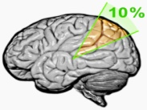
Grammatical barriers
CLI
First language has the potential to influence learners’ interlanguage (Lightbrown & Spada 2013).
Monitor Hypothesis
Affective filter hypothesis
Similarities between the L1 & L2 may cause ‘parasitic’ connections, and are thus taken as translation equivalents (Hall & Reyes 2009).
Acquisition and learning in second language production (Krashen 1982, p. 18).
Operation of the “affective filter” (Krashen 1982, p. 31).
Motivation, self-confidence and anxiety can all affect language acquisition (Krashen 1982).
Both learners!
Monitor over-users – Taiko
Monitor under-users – Andrei
Krashen (1982).
No evidence found for the learners in question. Competency = thinking in terms of L2? (Hall & Reyes 2009).
Thinking in terms of L2 – overgeneralization & simplification errors. (Lightbrown & Spada 2013).
Interlanguage
Articles = not particularly salient and don’t impose largely upon utterances’ meanings (Lightbrown & Spada 2013).
An internal, mental grammatical repertoire that learners construct throughout their language journey (Selinker 1972, cited by Ellis & Barkhuizen 2005).
Learned attention & Blocking
The fully L1 limits input analysis of L2 – Learned attention (Ellis & Wulff 2015).
Salient and redundant aspects of speech may be overlooked in favour of something reliable (Ellis & Wulff 2015).
Irregularities between two languages can make acquisition of some items harder. (Lightbrown & Spada 2013).
Permeable
variable
Fossilisation
Potential explanation for both learners: they may not be paying attention to articles in the input.

Slide 7
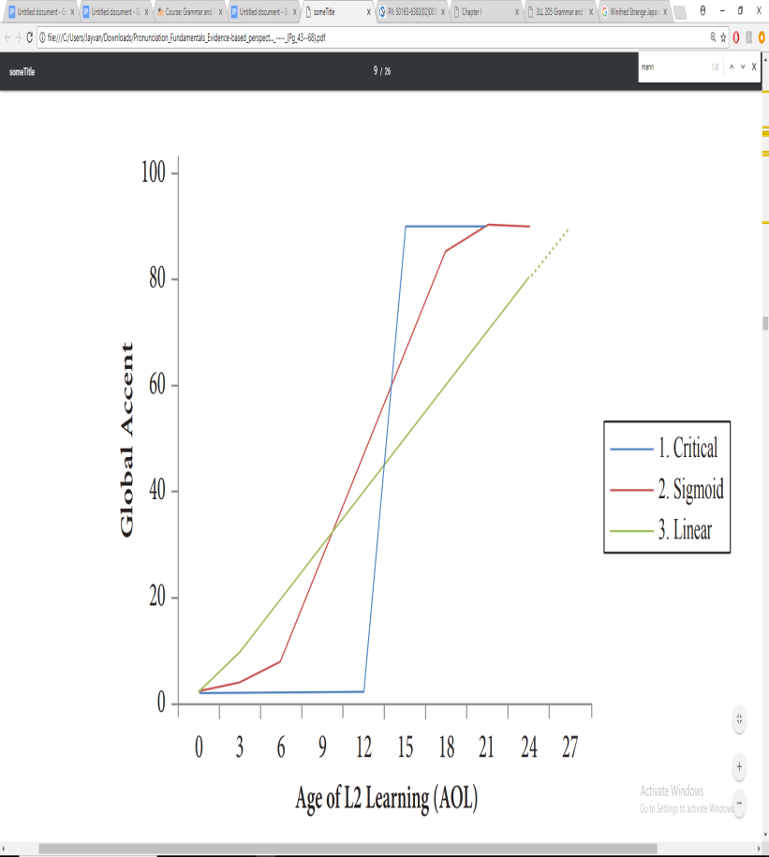
Phonetic barriers
Age
Language experience
Hypothetical relationships between age of L2 learning and degree of foreign accent (Munro & Mann 2005, adapted by Derwing & Munro 2015, p. 37).
Mature learners rarely obtain a ‘native’ level of pronunciation – even with considerable experience in the L2 (Derwing & Munro, 2015).
Length of residence (LOR) = potential implications for pronunciation
Long LOR = significant effect (Munro & Derwing 2008).
Long LOR = insignificant effect (Tsukada et al. 2005).
Age of learning (AOL) has been found to negatively correlate with L2 accent, i.e. not ‘native’ like (Munro & Mann 2005).
Evidence to suggest that learners who regularly seek interaction and integrate in the L2 country contributes to pronunciation gains than those who don’t (Derwing, Thomson and Munro 2006).
Taiko’s /l/-/r/ difficulties: evidence to suggest Japanese learner’s cannot perceive the difference! (Strange & Dittmann 1984).
Infants’ speech perception rapidly becomes focused on native language – can’t distinguish phonetical aspects of other languages (Werker & Tees 2002).
Potential critical period for pronunciation (DeKeyser 2000).
Obvious implications for learners with low WTC!

Slide 8
Implications and thoughts for teachers: the bigger picture
Obtaining a ‘native’ speaker level – difficult.
Leading to more bad than good – a vicious cycle.
Grammar
Pronunciation
Found and evidenced by Andrei & Taiko – more competency = less reliance on the L1 (Hall & Reyes 2009).
Intelligibility = word recognition (Derwing & Munro 1997).
Similarly, heavy Japanese accents have been found to be largely intelligible when IN context (Suenobu, Kanzaki & Yamane 1992).
Monitor under-users (Andrei) could benefit from explicit teaching, which helps learners notice any knowledge gaps (Ellis & Wulf 2015).
Both studies indicate that rather than worrying about accent, certain salient phonemes and general grammatical competency can increase intelligibility (Derwing & Munro 1997; Suenobu, Kanzaki & Yamane 1992).
Monitor under-users could benefit from an approach which factors their fragility in mind, e.g. a focus on form (Keck & Kim 2014).
Interlanguage possesses a considerable amount of instability – this is to be expected, however, as learners get closer to target norms (Ellis & Barkhuizen 2005).
Suggested that there is no fossilisation in pronunciation (Thomson & Derwing 2014).
Most importantly, students need to reminded that although the ‘native’ speaker goal is unattainable, it is not necessary! (Cook 2016).
Important that teachers don’t burden themselves and learners with the archaic nativeness principle; instead, adopt the intelligibility principle! (Levis 2005).

Slide 9
Conclusion
In terms of attitudes to language, L2- speakers of English can be motivated both extrinsically and intrinsically Compared to a high percentage of, for example, British L1 English speakers.
Through prescribers of English and attitudes of ‘native’ speakers, there are clear negative effects on language learners/potential language learners
The learners I interviewed felt these effects especially, and developed communication issues which impeded their integration, self-efficacy and further language learning.
Individual barriers looked at both learners who voiced frustration over the difficulties and differences of English – these correlated with myths which are commonly believed amongst linguists and learners.
There are a number of grammatical and phonetical barriers which may never see learners attain ‘native’ speaker level. The ‘native’ speaker desire also was shown to slow or deprive learners in a number of ways.
There are a number of considerations teachers must keep in mind: although learners may never reach ‘native’ like pronunciation and grammar they can still make progress and communicate successfully in English
Teachers must also take responsibility in easing the unattainable ‘native’ speaker target

Slide 10
The end!
All citations, graphs and diagrams have been appropriately cited, and can be found in the following reference slides.
Images are free to use and share and were searched for via Google’s advanced search function.
Thank you for watching!

Slide 11
References
Coleman, J. (2009) Why the British do not learn languages: myths and motivation in the United Kingdom [Internet]. Available from
http://oro.open.ac.uk/23568/1/Coleman_2009_Why_the_British_do_not_learn_languages.pdf [Accessed 28th February 2018].
Cook, V. (2016) Second Language Learning and Language Teaching. 5th ed. [Internet] New York, Routledge. Available from https://www.dawsonera.com/abstract/9781315883113 [Accessed 8th March 2018]. DeKeyser, R. (2000) The robustness of critical period effects in second language acquisition. Studies in Second Language Acquisition, 22 (4), pp. 499-535.
Derwing, T. and Munro, M (2015) Pronunciation fundamentals: evidence-based perspectives for L2 teaching and research. Language learning & language teaching 42. Amsterdam, John Benjamins Publishing Company.
Derwing, T. and Munro, M. (1997) Accent, Intelligibility, and Comprehensibility: Evidence from four L1s. Studies in Second Language Acquisition, 19 (1), pp. 1–16.
Derwing, T. Thomson, R. and Munro, M. (2006) English pronunciation and fluency development in Mandarin and Slavic speakers. System: An International Journal of Educational Technology and Applied Linguistics, 34 (2), pp. 183-193.
Ellis, R. and Barkhuizen G. (2005) Analysing Learner Language. Oxford, Oxford University Press. Available from https://www.dawsonera.com/readonline/9780203080023 [Accessed 3rd March 2018].
Ellis, C, N. and Wulff, S. (2015) Usage-based approaches to SLA. In: VanPatten, B. & Williams, J. 2nd ed. Theories in Second Language Acquisition: An Introduction [Internet]. New York, Routledge, pp. 75-93. Available from https://ebookcentral-proquest-com.yorksj.idm.oclc.org/lib/yorksj/reader.action?docID=1829286&ppg=88 [Accessed 9th March 2018].
Hall, C. & Reyes, D, A. (2009) Cross-linguistic influence in L2 verb frames: The effects of word familiarity and language proficiency. In: Benati, G, M. Issues in Second Language Proficiency [Internet]. London, Continuum, pp. 24-44. Available from http://lib.myilibrary.com.yorksj.idm.oclc.org/Open.aspx?id=229703 [Accessed 7th March 2018].
Hall, C. Smith, P. and Wicaksono, R. (2017) Mapping applied linguistics: a guide for students and practitioners. 2nd ed. London, Routledge.
Keck, C. K. Kim, Y. (2014) Pedagogical grammar. Amsterdam, John Benjamins Publishing Company.
Krashen, S. D. (1982) Principles and Practice in Second Language Acquisition [Internet]. Pergamon Press Inc. Available from http://www.sdkrashen.com/content/books/principles_and_practice.pdf [Accessed 5th March 1982]. Levis, J. (2005) Changing contexts and shifting paradigms in pronunciation teaching. TESOL Quarterly [Internet], 39 (3), pp. 369-377. Available from https://capitadiscovery.co.uk/yorksj/items/eds/edsjsr/edsjsr.10.2307.3588485?query=Changing+Contexts+and+Shifting+Paradigms+in+Pronunciation+Teaching&resultsUri=items%3Fquery%3DChanging%2BContexts%2Band%2BShifting%2BParadigms%2Bin%2BPronunciation%2BTeaching%26facet%255B0%255D%3Dfulltext%253Ayes%26target%3Deds&facet%5B0%5D=fulltext%3Ayes&target=eds [Accessed 12th March 2018].
Lightbrown, M. P. & Spada, M. (2013) How Language are Learned. 4th ed. Oxford, Oxford University Press.

Slide 12
MacIntyre, P. Dornyei, Z. Clement, R. and Noels, K. (1988) Conceptualizing Willingness to Communicate in a l2: a situational model of L2 confidence and affiliation. The Modern Language Journal, 82 (4), pp. 545-562.
Modern Language Association of America (no date) Benefits of Language Learning [Internet]. Available from https://www.mla.org/Resources/Advocacy/Infographics/Infographic-Benefits-of-Language-Learning [Accessed 2nd March 2018].
Munro, M. and Derwing, T. (2008) Segmental acquisition in Adult ESL learners: a longitudinal study of vowel production. Language Learning, 58 (3), pp. 479-502.
Munro, M. and Mann, V. (2005) Age of immersion as a predictor of foreign accent. Applied Psycholinguistics [Internet], 26 (3), pp. 311-341. Available from https://www-cambridge-org.yorksj.idm.oclc.org/core/services/aop-cambridge-core/content/view/EB8DAE82BC1152B91E9EC7A2BE929B23/S0142716405050198a.pdf/age_of_immersion_as_a_predictor_of_foreign_accent.pdf [Accessed 7th March 2018].
Schmidt, R. and Watanabe, Y. (2001) Motivation, strategy use, and pedagogical preferences in foreign language learning. In: Dornyei, Z. and Schmidt, R. ed. Motivation and second language acquisition. Honolulu: University of Hawaii, pp. 313-359.
Sheldon, K. and Elliot, A. (1999) Goal striving, Need satisfaction, and Longitudinal Well-Being: The Self-Concordance Model. Journal of Personality and Social Psychology, 76 (3), pp. 482-497.
Strange, W. and Dittmann, S. (1984) Effects of discrimination training on the perception of /r-l/ by Japanese adults learning English. Perception & Psycholinguistics, 36 (2), pp. 131-145.
Suenobu, M. Kanzaki, K. and Yamane, S. (1992) An Experimental Study of Intelligibility of Japanese English. International Review of Applied Linguistics in Language Teaching, 30 (2), pp. 146-156.
Thomson, R. and Derwing, T. (2014) The effectiveness of L2 pronunciation instruction: a narrative review. Applied Linguistics [Internet], 36 (3), pp. 326-344. Available from https://www.researchgate.net/publication/271827649_The_Effectiveness_of_L2_Pronunciation_Instruction_A_Narrative_Review [Accessed 10th March 2018].
Tsukada, K. Birdsong, D. Bialystok, E. Mack, M. Sung, H. and Flege, J. (2005) A developmental study of English vowel production and perception by native Korean adults and children. Journal of Phonetics [Internet], 33 (3), pp. 263-290. Available from http://www.jimflege.com/files/Tsukada_Birdsong_developmental_study_JP_2005.pdf [Accessed 9th March 2018].
UOE data collection (2015) Foreign language learning in the EU: upper secondary education [Internet]. Available from http://ec.europa.eu/eurostat/statistics-explained/index.php/Foreign_language_learning_statistics [Accessed 1st March 2018].
Werker, J. and Tees, R. (2002) Cross-language speech perception: evidence for perceptual reorganization during the first year of life. Infant Behavior & Development, 25 (1), pp. 121-133.
Wicaksono, R. (2013) Raising students’ awareness of the construction of communicative (in)competence in international classrooms. In: Ryan, J. ed. Cross cultural teaching and learning for home and international students: Internationalisation of pedagogy and curriculum in Higher Education [Internet]. London: Routledge, pp. 241-250. Available from https://capitadiscovery.co.uk/yorksj/items/89028?query=Cross+cultural+teaching+and+learning+for+home+and+international+students%3A+Internationalisation+of+pedagogy+and+curriculum+in+Higher+Education&resultsUri=items%3Fquery%3DCross%2Bcultural%2Bteaching%2Band%2Blearning%2Bfor%2Bhome%2Band%2Binternational%2Bstudents%253A%2BInternationalisation%2Bof%2Bpedagogy%2Band%2Bcurriculum%2Bin%2BHigher%2BEducation%26facet%255B0%255D%3Dfulltext%253Ayes%26target%3Dcatalogue&facet%5B0%5D=fulltext%3Ayes&target=catalogue [Accessed 15th February 2018].

